Slide 1
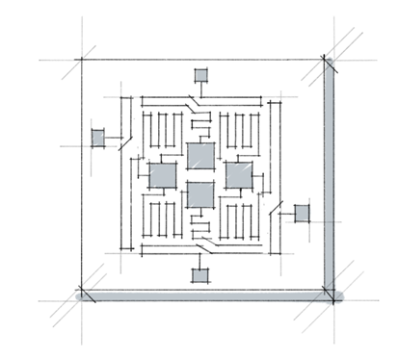
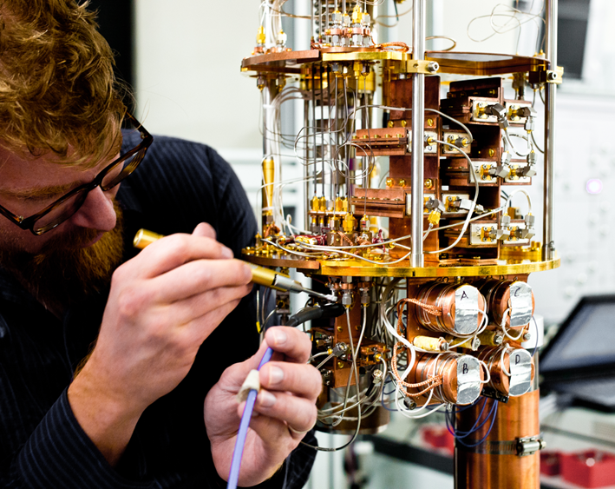
Intro to Quantum Computing
qbits.bitsgoa

Slide 2
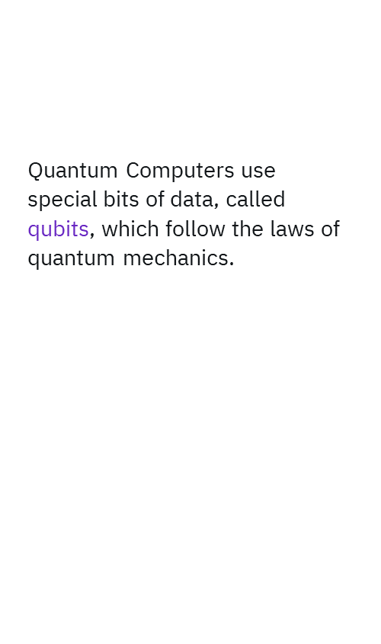
Using these techniques, quantum computers harness nature to compute problems that are too large for classical computers to solve
We these laws to our advantage, enabling us to put qubits into superposition or to create entanglement.

Slide 3
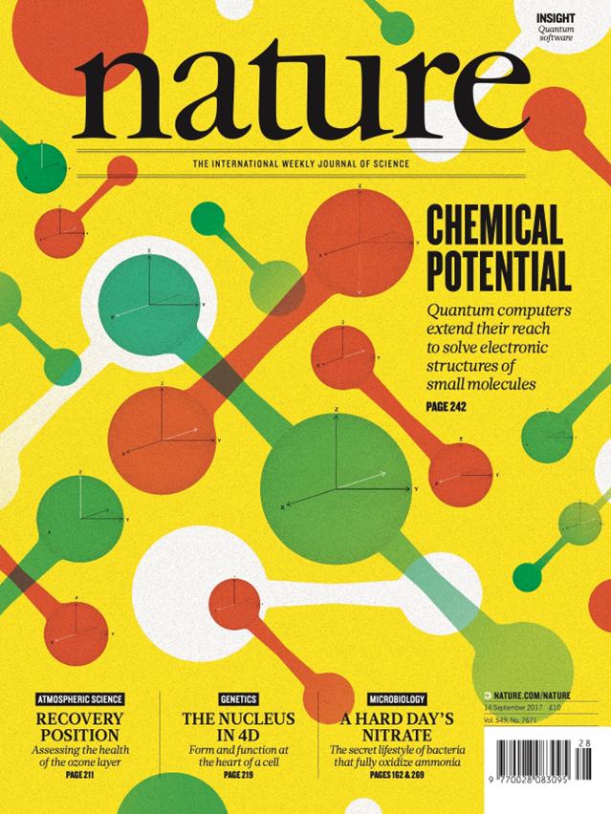
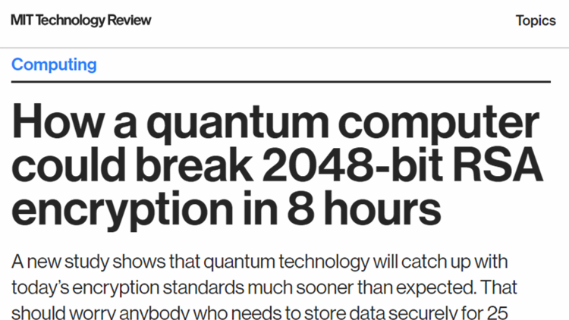
Notes:
Here’s one of the chemistry experiments that made the cover of Nature magazine. IBM scientists used a quantum computer to simulate the molecule Lithium Hydride. Then, one year after the initial findings, they were able to find a 10x improvement in fidelity using the exact same hardware, just by finding a new error mitigation techniques and applying them in the code they used.
Advancing the field of quantum computing is both a hardware and software problem.

Slide 4
LINEAR ALGEBRA

Slide 5
Today, we aim to cover the following
Vector Spaces
Conjugate transpose
Inner product
Normalization

Slide 6
Vector Space
Set V on which two operations + and · are defined, called vector addition and scalar multiplication.
Let u, v, w ∈ V, c, d ∈ ℂ ,the set has the following axioms -
u + v ∈ V
u + v = v + u
u + (v + w) = (u + v) + w
The set V contains an additive identity element, denoted by 0, such that 0 + v = v and v + 0 = v
v + x = 0 and x + v = 0 have a solution x in V, called an additive inverse of v, and denoted by - v
c · v ∈ V
c · (u + v) = c · u + c · v
(c + d) · v = c · v + d · v
c · (d · v) = (cd) · v
1 · v = v

Slide 7
Dirac Notation
In QM, we use the bra-ket notation.
Here, you’ll see vectors written as: |v⟩ This is called a ket-vector:
It’s essentially a column vector consisting of two complex elements. |v⟩ = =
We’ll explain bra-vector in the later slides.
A
B
2+3i
5i

Slide 8
Matrix time
The operations we define on matrices are extremely important in quantum mechanics and quantum computing!
Matrices are how we will represent qubits, and build the quantum gates that will manipulate these qubits.
We’ll talk about that in some time

Slide 9
Matrix time
CONJUGATE TRANSPOSE (†)
Conjugate transpose of matrix A = A† (pronounced A dagger)
For an m×n matrix A, A† is an n×m matrix such that
A† [ i ] [ j ] = A*[ j ] [ i ]
2 + i
3 + 4i
A =
A† =
2 - i | 3 - 4i

Slide 10
Matrix time
CONJUGATE TRANSPOSE BUT QUANTUM (spooky ghost noises)
Dirac notation of a vector: |v⟩
Conjugate transpose of vector: ⟨v|
|v⟩ =
⟨v| = |v⟩† =
⟨v|v⟩ = inner product = 38
2 + 3i
5i
2 - 3i | -5i

Slide 11
Linear Transformations
Say you have two vector spaces U and V. A linear transformation is a mapping that “maps” a vector from one vector space to another.
Sort of like a “function”.
It has a set of properties though:
L(u) = v, where u and v are vectors in U and V respectively.
L(au + bw) = a* L(u) + b* L(w), where a and b are scalars.

Slide 12
Matrix time: Eigen-stuff
EIGENVALUES
For a vector v, eigen values λ are defined such that
Av = λv for some v, where A is a matrix
⇒ (λI - A)v = 0 (Characteristic equation)
3 | 4
1 | 2
A =

Slide 13
Matrix time
EIGENVALUES
λ - 3 | 4
1 | λ - 2
λI - A =
= 0
(λ - 3)(λ - 2) - 4 = 0
λ² - 5λ+2 = 0
= 5/2 ± √17/2

Slide 14
Matrix time
TENSOR PRODUCT/ KRONECKER PRODUCT
a₀
a₁
a₀b₀₀ | a₀b₀₁
a₀b₁₀ | a₀b₁₁
a₁b₀₀ | a₁b₀₁
a₁b₁₀ | a₁b₁₁
A =
a₀B
a₁B
A ⊗ B =
=
b₀₀ | b₀₁
b₁₀ | b₁₁
B =
Notes:
Say that this takes two matrices and makes a bigger matrix

Slide 15
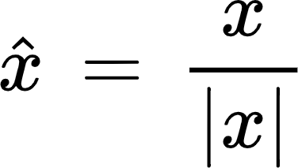
Matrix time
NORMALISATION
The normalized vector if x is a vector in the same direction but with a norm(length) = 1. It is denoted by x and given by
This is also known as unit vector. We’ll deal with this when we talk about probabilities of quantum systems.
⟨a|a⟩ = 1

Slide 16
UNITARY MATRIX
A square matrix whose
Conjugate transpose = Inverse
Square matrix U such that
U† = U⁻¹
^{Or in other words}
UU† = U†U = I

Slide 17
QUANTUM GATES

Slide 18
What is a state of a quantum mechanical particle?
They are just vectors form a specific vector space called as a Hilbert space!

Slide 19
BASIS STATES
While working in any space we define some reference states to work in them. For example in the argand plane we use 1, i or on real space we use x y z coordinates. Similarly for Quantum States depending upon the size of the space we basis for these. For any n-D space we need n linearly independent vectors. For sake of simplicity we chose orthogonal vectors
Notes:
Orthogonality in any two vectors is such that dot product is 0. So a.b = 0. For functions we do ∫φ.ψ = 0

Slide 20
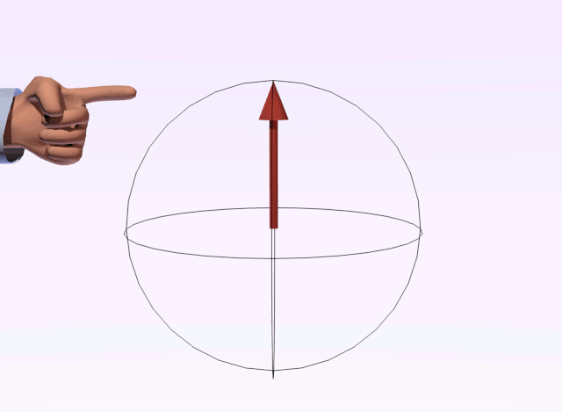
Qubits!
Qubits are two level quantum systems.They are quantum analogue of a classical bit is a qubit.
It can have the values |0⟩, |1⟩, or a linear combination of both.
|0⟩ and |1⟩ are the orthogonal z-basis states

Slide 21
Measurement?
It is the act of taking information out of a quantum mechanical system
What kind of information we take out of the system is the “basis of measurement”
For example if I am trying to know position of a particle, then I am measuring it in position basis, if I am trying to know the momentum of a particle, then I am measuring it in momentum basis
Measuring a particle changes it’s state!

Slide 22

SUPERPOSITION
Fundamental property of a quantum mechanics
Any two (or more) quantum states can be added together ("superposed") and the result will be another valid quantum state
Conversely, every quantum state can be represented as a sum of two or more other distinct states (This is very important for us!!).
Any qubit state can be represented as the linear combination or “superposition” of the two basis vectors, |0⟩ and |1⟩.
We’ll see an example to see how the superposition works.

Slide 23
Matrix Representation of a qubit
A complex vector of size 2-
α
β
1
0
|0⟩ =
α
β
1
0
0
1
=
α
+
β
0
1
|1⟩ =

Slide 24
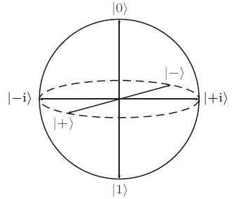

Bloch Sphere
∣ψ⟩ = cos(θ/2) ∣0⟩ + e^{iϕ}sin(θ/2) ∣1⟩
0 ≤ θ ≤ 𝝅
0 ≤ ϕ < 2𝝅
Global phase does not matter.
x = sinθ cosϕ
y = sinθ sinϕ
z = cosθ

Slide 25
Basis vectors of 2 qubits systems
1
0
0
0
0
1
0
0
|00⟩ = |0⟩ ⊗|0⟩ =
|01⟩ = |0⟩ ⊗|1⟩ =
0
0
1
0
0
0
0
1
|10⟩ = |1⟩ ⊗|0⟩ =
|11⟩ = |1⟩ ⊗|1⟩ =
Notes:
Orthogonality in any two vectors is such that dot product is 0. So a.b = 0. For functions we do ∫φ.

Slide 26
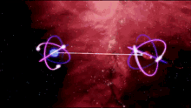
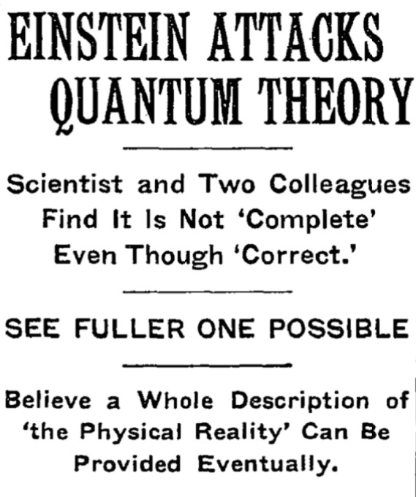
ENTANGLEMENT
Quantum entanglement is a close connection between a pair or groups of quantum systems.
When 2 such quantum systems come close together and interact with one another, they become entangled.
When 2 systems are entangled, a change in state of one causes an immediate change of state in the other system as well no matter how far the two systems are.
So, if you happen to observe and determine the state of one of these system, you immediately know the state of the other without having to observe it.

Slide 27
QUANTUM GATES
A gate that operates on N qubits is represented as a 2^{N} × 2^{N} unitary matrix.
For example, a gate that operates on 1 qubit is represented by a 2 × 2 unitary matrix.
Tensor product is used to combine quantum states.
Notes:
Orthogonality in any two vectors is such that dot product is 0. So a.b = 0. For functions we do ∫φ.

Slide 28
PAULI GATES
0 | 1
1 | 0
X|0⟩ = |1⟩
X|1⟩ = |0⟩
X gate is similar to the classical NOT gate.
X gate :
0 | -i
i | 0
Y|0⟩ = i|1⟩
Y|1⟩ = -i|0⟩
Y gate :
1 | 0
0 | -1
Z|0⟩ = |0⟩
Z|1⟩ = -|1⟩
Z gate :
Notes:
Orthogonality in any two vectors is such that dot product is 0. So a.b = 0. For functions we do ∫φ.

Slide 29
OTHER IMPORTANT GATES
1 | 1
1 | -1
H|0⟩ = |+⟩
H|1⟩ = |-⟩
H gate :
1
√2
1 | 0 | 0 | 0
0 | 1 | 0 | 0
0 | 0 | 0 | 1
0 | 0 | 1 | 0
CNOT|00⟩ = |00⟩
CNOT|01⟩ = |01⟩
CNOT|10⟩ = |11⟩
CNOT|11⟩ = |10⟩
CNOT gate is similar to the classical XOR gate.
CNOT gate :
Notes:
Orthogonality in any two vectors is such that dot product is 0. So a.b = 0. For functions we do ∫φ.

Slide 30
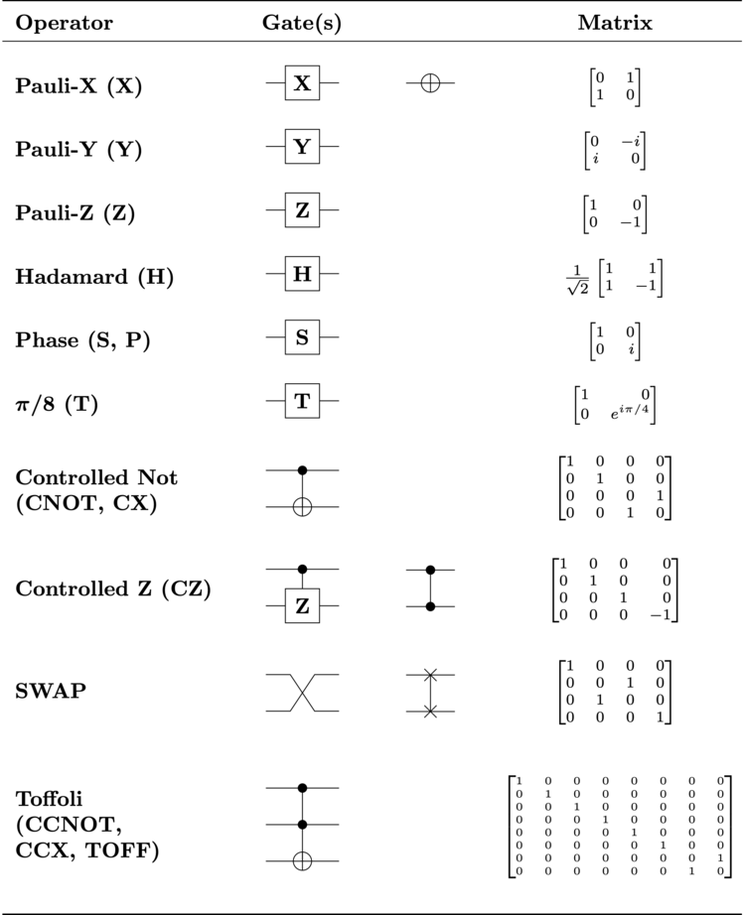
OTHER IMPORTANT GATES
Notes:
Orthogonality in any two vectors is such that dot product is 0. So a.b = 0. For functions we do ∫φ.

Slide 31


QISKIT
Qiskit is a library written in python used to programming IBM’s quantum computers.
You can use any quantum system and library. But we recommend qiskit & IBM QE so that you can follow along

Slide 32
THANK YOU
&
QnA

